Slide 1


Mastering Risk Management
The ultimate survival shield: Position sizing, stop losses, and psychological mastery in the markets.

Slide 2


The Foundation: Position Sizing
Position sizing is the calculation of how much capital to risk on a single trade, independent of your stock choice.
The 1% Rule: Professional traders never risk more than 1% to 2% of their total trading portfolio on any single trade.
Capital Preservation: Even if you suffer a 10-trade losing streak, your account remains virtually intact to fight another day.
Bet Sizing: Higher volatility stocks require smaller position sizes to keep total dollar risk constant.

Slide 3

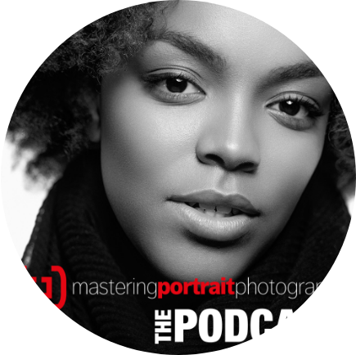
The Safety Net: Stop Loss
Accepting Defeat Early
A stop loss is a pre-determined exit order that automatically cuts your losses when a trade moves against your thesis.
Removing Emotion: By pre-defining your exit, you prevent panic-driven hope and emotional paralysis.
Technical Placement: Always place stop losses below logical support or structural chart levels, never based on random dollar amounts.

Slide 4
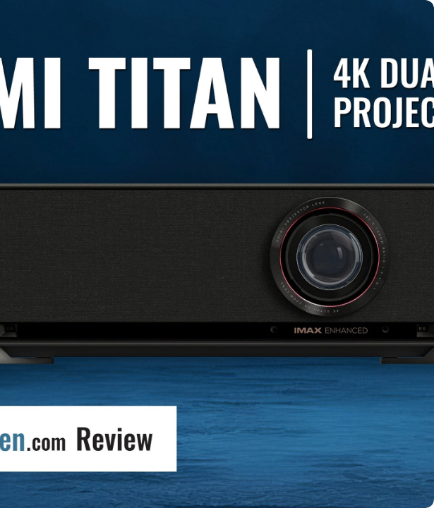

Asymmetric Math:
Risk Reward Ratio
The Risk-Reward Ratio (RRR) compares the potential profit of a trade against its potential loss.
The 1:2 or 1:3 Rule: If you risk ₹1,000, your target profit must be at least ₹2,000 to ₹3,000. With a 1:2 ratio, you can be wrong 50% of the time and still make consistent profits!

Slide 5


The Inner Battle: Trading Psychology
Fear & Greed
Discipline & Process
Markets are driven by human emotion. Fear makes you exit winning trades too early, while greed makes you hold losing trades hoping for a miracle.
Professional traders treat trading like a boring business, not a casino.
Journaling: Documenting every trade, emotional state, and rule deviation is the only way to build lifelong market mastery.
Revenge Trading: Trying to instantly win back losses after a bad trade is the #1 account killer for beginners.

Slide 6
Great Job on Day 25!
You have completed Day 25 - Risk Management & Trading Psychology.
Stay disciplined, protect your capital, and invest wisely!
/YourFinanceProfessor
@FinanceProf_Official

Slide 7


Image Sources
http://googleusercontent.com/image_collection/image_retrieval/6269302494552419471_0
Source: Google Image Retrieval
http://googleusercontent.com/image_collection/image_retrieval/4937959821528719309_0
Source: Google Image Retrieval
http://googleusercontent.com/image_collection/image_retrieval/663298148922784235_0
Source: Google Image Retrieval

Slide 8



Image Sources
https://www.wantmattress.com/cdn-cgi/image/format=webp,fit=cover,width=600,height=450/assets/product_images/Media_Glow_Ottoman_TV_Bed_Frame_With_Sound_Activated_Lighting.jpg
Source: www.wantmattress.com
https://pbcdn1.podbean.com/imglogo/image-logo/1125335/Cover_Image_202582hr0.jpg
Source: podcast.masteringportraitphotography.com
https://www.projectorscreen.com/cdn/shop/articles/PSCO-Blog-Cover-XGIMI-Titan-R0_copy.jpg?v=1774450911&width=3000
Source: www.projectorscreen.com

